Slide 1
Intermediate Presentation
- Interactive Score Annotation for MIR -
Fernando Perry de Azeredo
up202308655@up.pt
FEUP 2026

Slide 2
Thesis & Dissertation Goal

Slide 3
Work Timeline
BeatMapJS (Work Period)
  Goal:
  Developed Features:
  Pros&Cons:
MEI-Basic-Edit (Work Period)
  Goal:
  Developed Features:
  Pros&Cons:
Piano-Precision Fork (Work Period)
  Goal:
  Developed Features:
  Pros&Cons:

Slide 4
Work Timeline
Score-Allignment.py (Work Period)
  Goal:
  Developed Features:
  Pros&Cons:
Score-Allignment.js (Work Period)
  Goal:
  Developed Features:
  Pros&Cons:

Slide 5
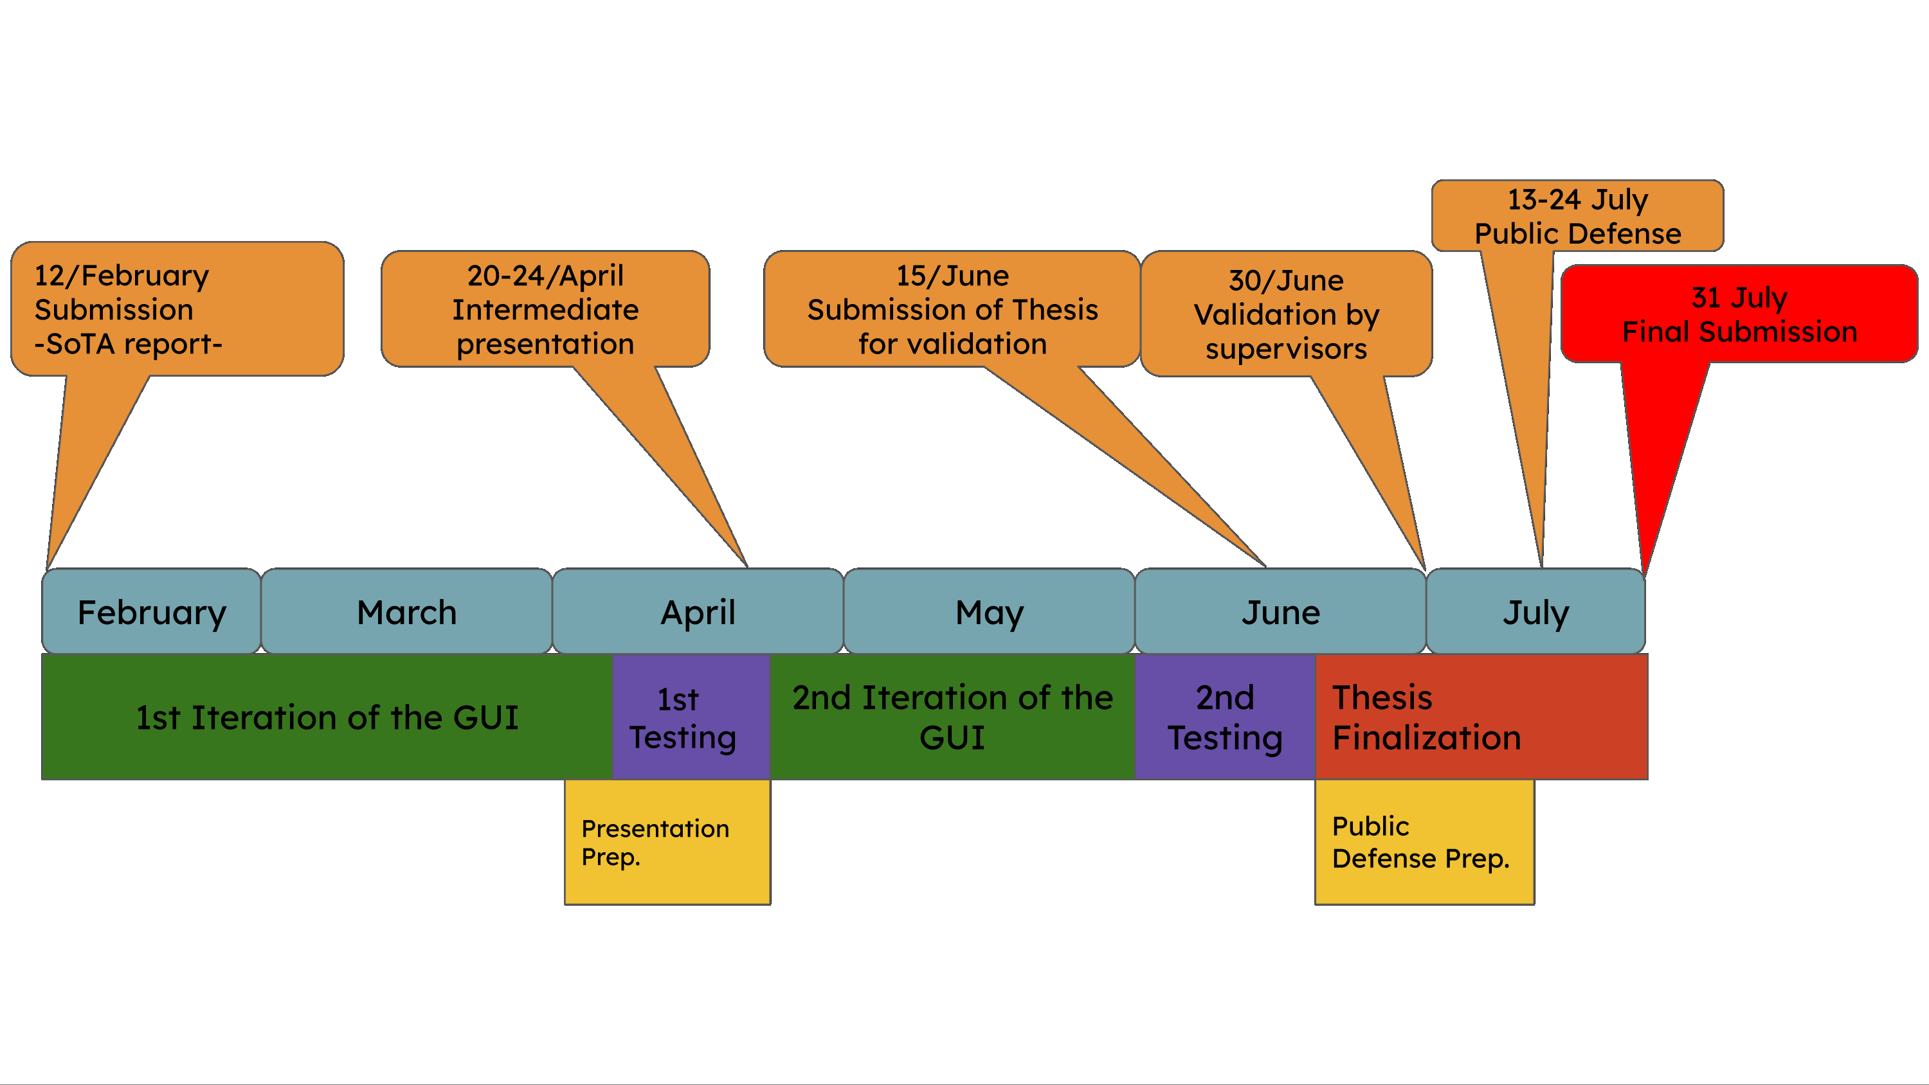
Sota Timeline and Goals

Slide 6
What went well so far

Slide 7
What went bad

Slide 8
Updated Workplan

Slide 9
Status
Current work status: Normal to Late
Conclusion forecast: Probable

Slide 10
References
Dixon, S. (2007). Evaluation of the Audio Beat Tracking System BeatRoot. Journal of New Music Research, 36(1), 39–50. DOI: 10.1080/09298210701653310
Masataka Goto, Kazuyoshi Yoshii, Hiromasa Fujihara, Matthias Mauch, and Tomoyasu Nakano. "Songle: A Web Service for Active Music Listening Improved by User Contributions." In Proceedings of the 12th International Society for Music Information Retrieval Conference (ISMIR 2011)
Yamamoto, K. (2021). “Human-in-the-Loop Adaptation for Interactive Musical Beat Tracking.” In Proceedings of the 22nd International Society for Music Information Retrieval Conference (ISMIR)
Desblancs, D., Lostanlen, V., & Hennequin, R. (2023). "Zero-Note Samba: Self-Supervised Beat Tracking." IEEE/ACM Transactions on Audio, Speech, and Language Processing, vol. 31, pp. 2922–2934. DOI: 10.1109/TASLP.2023.3297963
Foscarin, F., Schlüter, J., & Widmer, G. (2024). "Beat this! Accurate beat tracking without DBN postprocessing". In Proceedings of the 25th International Society for Music Information Retrieval Conference (ISMIR 2024), San Francisco, United States
Jiang, Y., Weigl, D. M., & Goebl, W. (2025). “Piano Precision: Advancing Music Performance Analysis by Integrating User-Correctable Audio-to-Score Alignment”
Liu, Z., & Donahue, C. (2025). "OSU2MIR: Beat Tracking Dataset Derived From Osu! Data." In Extended Abstracts for the Late-Breaking Demo Session of the 26th International Society for Music Information Retrieval Conference (ISMIR 2025), Daejeon, South Korea.
Ru, G., Wang, J., Zhao, J., Wu, Y., Yu, Y., Jiang, N., Wang, W., & Li, W. (2025). "HingeNet: A Harmonic-Aware Fine-Tuning Approach for Beat Tracking"

Slide 11
Questions?

